Slide 1
The Particle Swarm Optimization (PSO) Algorithm and Pesudo code

Slide 2
Introduction to PSO
Introduction to PSO Algorithm
Algorithm – Parameters
PSO Flow Chart
Algorithm – Digramatic Example of PSO
Mathematical Example
Pseudo Code of PSO

Slide 3
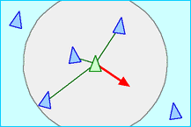
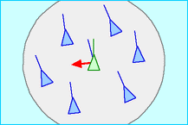
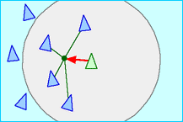
Introduction
Inspired from the nature social behavior and dynamic movements with communications of insects, birds and fish
In 1986, Craig Reynolds described this process in 3 simple behaviors:
Separation
avoid crowding local flockmates
Alignment
move towards the average heading of local flockmates
Cohesion
move toward the average position of local flockmates

Slide 4
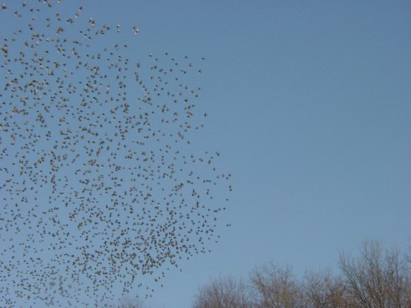
Introduction to the PSO: Concept
Uses a number of agents (particles) that constitute a swarm moving around in the search space looking for the best solution
Each particle in search space adjusts its “flying” according to its own flying experience as well as the flying experience of other particles

Slide 5
Algorithm - Neighborhood
geographical
social

Slide 6
Algorithm - Neighborhood
global

Slide 7
Algorithm - Parameters
Algorithm parameters
A : Population of agents
p_{i} : Position of agent a_{i} in the solution space
f : Objective function
v_{i} : Velocity of agent’s a_{i}
V(a_{i}) : Neighborhood of agent a_{i} (fixed)
The neighborhood concept in PSO is not the same as the one used in other meta-heuristics search, since in PSO each particle’s neighborhood never changes (is fixed)

Slide 8
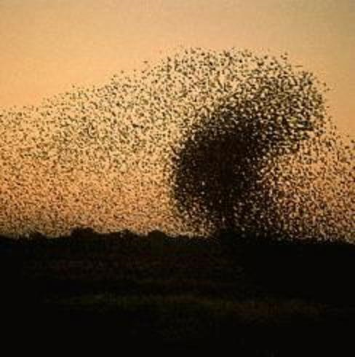
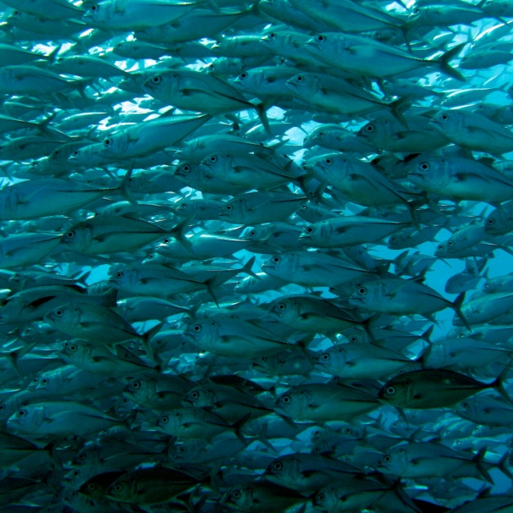
Introduction to PSO Algorithm
[x*] = PSO()
P = Particle_Initialization();
For i=1 to it_max
For each particle p in P do
fp = f(p);
If fp is better than f(pBest)
pBest = p;
end
end gBest = best p in P;
For each particle p in P do
v = v + c1*rand*(pBest – p) + c2*rand*(gBest – p);
p = p + v; end end

Slide 9
Algorithm
Particle update rule
p = p + v
with
v = v + c₁ * rand * (pBest – p) + c₂ * rand * (gBest – p)
where
p: particle’s position
v: path direction
c₁: weight of local information
c₂: weight of global information
pBest: best position of the particle
gBest: best position of the swarm
rand: random variable
Notes:
c1, c2 : The balance factors between the effect of self-knowledge and social knowledge in moving the particle towards the target. Usually the value 2 is suggested for both factors in the literature)
rand :A random number between 0 and 1, and different at each iteration
w : Inertia weight
pbest : The best position of a particle
gbest : The best position within the swarm
prtvel : The velocity of jth particle in ith iteration
prtpos : The position of jth particle in ith iteration

Slide 10
Algorithm - Parameters
Number of particles usually between 10 and 50
C₁ is the importance of personal best value
C₂ is the importance of neighborhood best value
Usually C₁ + C₂ = 4 (empirically chosen value)
If velocity is too low → algorithm too slow
If velocity is too high → algorithm too unstable

Slide 11
Algorithm
Create a ‘population’ of agents (particles) uniformly distributed over X
Evaluate each particle’s position according to the objective function
If a particle’s current position is better than its previous best position, update it
Determine the best particle (according to the particle’s previous best positions)

Slide 12
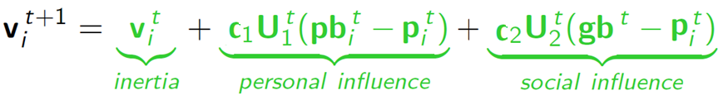

Algorithm
Update particles’ velocities:
Move particles to their new positions:
Go to step 2 until stopping criteria are satisfied

Slide 13
Algorithm
Particle’s velocity:
1. Inertia
Makes the particle move in the same direction and with the same velocity
Improves the individual
Makes the particle return to a previous position, better than the current
Conservative
2. Personal Influence
3. Social Influence
Makes the particle follow the best neighbors direction

Slide 14
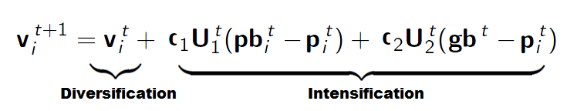
Algorithm
Intensification: explores the previous solutions, finds the best solution of a given region
Diversification: searches new solutions, finds the regions with potentially the best solutions
In PSO:

Slide 15
Flow Chart

Slide 16
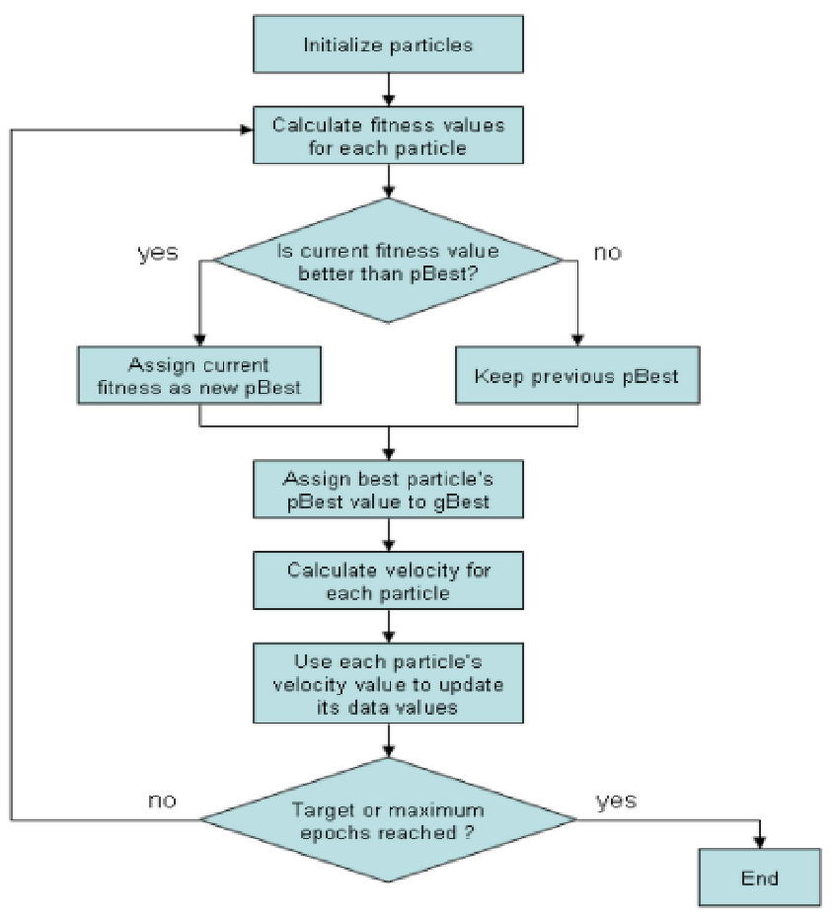
Flow Diagram

Slide 17
Algorithm – Digramatic Example

Slide 18
Algorithm – Digramatic Example
Intensification: explores the previous solutions, finds the best solution of a given region
Diversification: searches new solutions, finds the regions with potentially the best solutions

Slide 19
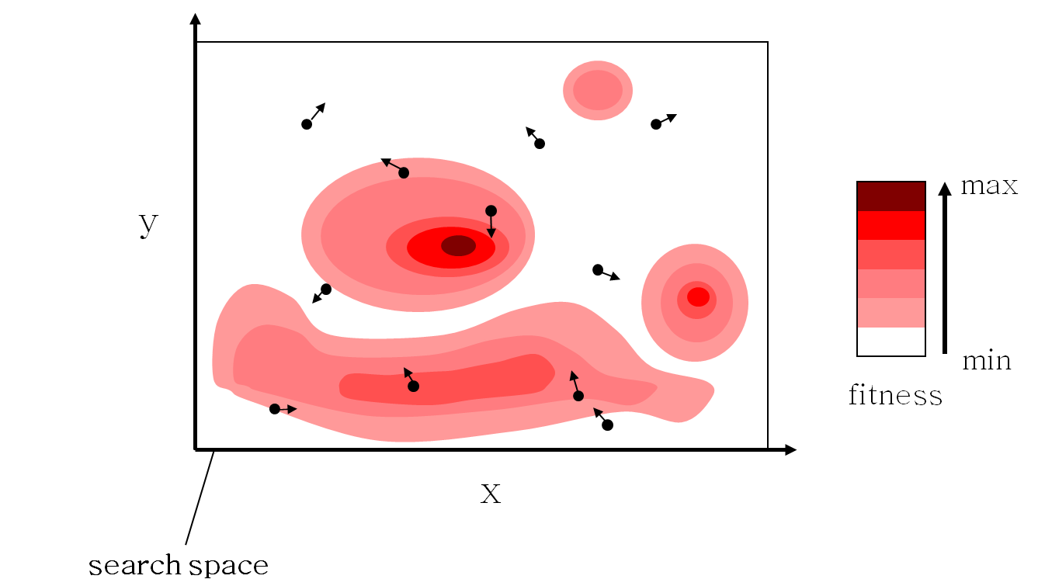
Algorithm – Digramatic Example i

Slide 20
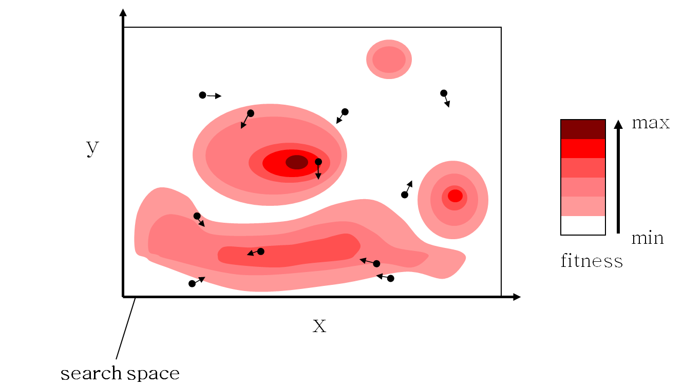
Algorithm – Digramatic Example ii

Slide 21
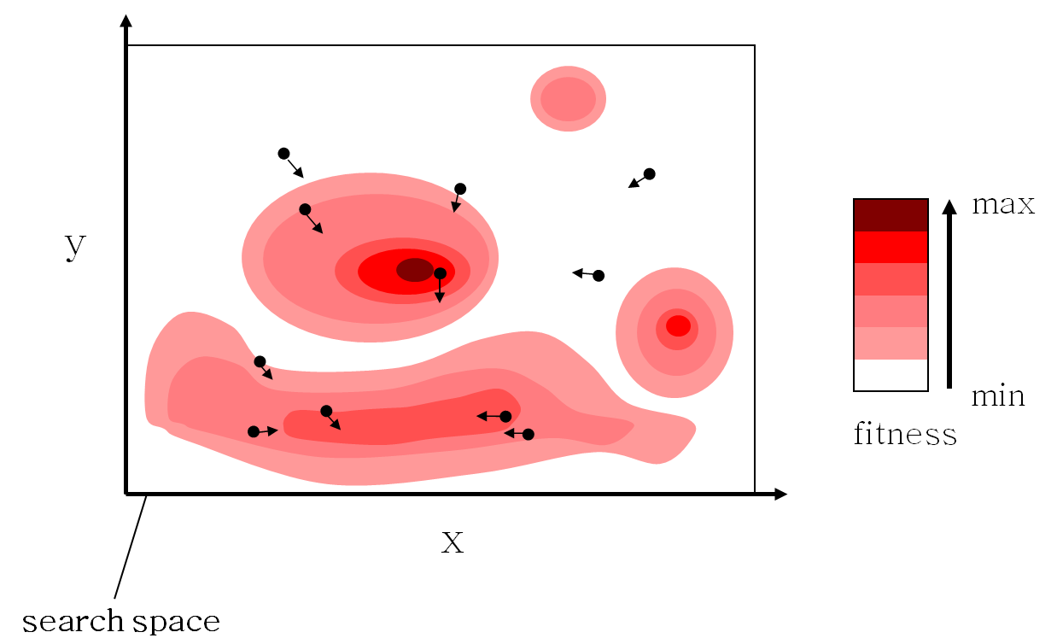
Algorithm – Digramatic Example iii

Slide 22

Algorithm – Digramatic Example iv

Slide 23

Algorithm – Digramatic Example v

Slide 24
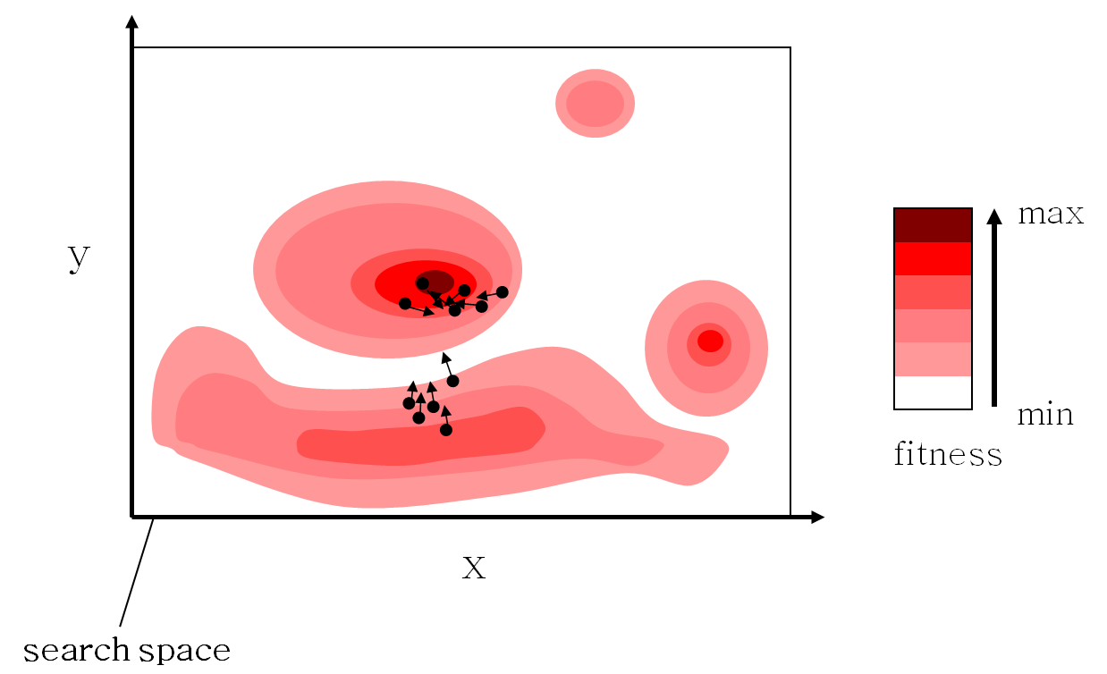
Algorithm – Digramatic Example vi

Slide 25
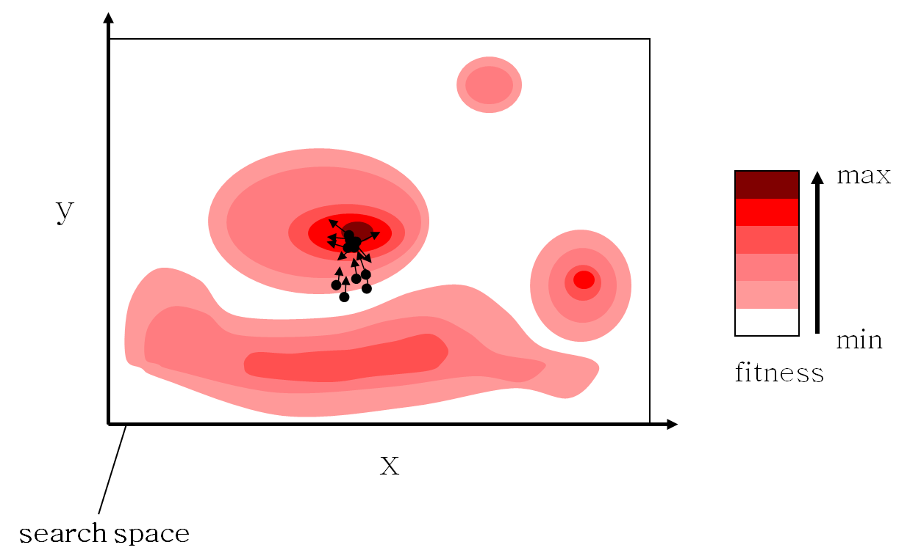
Algorithm – Digramatic Example vii

Slide 26

Algorithm – Digramatic Example viii

Slide 27
Mathematical Example

Slide 28
Mathematical Example
We are having the maximization function and here we want to maximize the value of Y
Formula
Vi +1 = w*Vi + r1*c1(Pbest-xi) + r2*c2(Gbest-xi)
X_{i} + 1 = X_{i} + V_{i} +1
Equation
Max Y =x₁² – 3x₂ + 10
Values
Population size =5
w=0.65 (inertia/weight important parameter)
c1= 1.65 (Self cognitive level)
c2= 1.75 (social cognitive level)
r1= 0.4 (random values)
(r2= 0.1 ( random values)

Slide 29
Mathematical Example –i Population size =5
X1 | X2
2 | 3
1 | 2
2 | 1.5
2.5 | 1
3 | 2

Slide 30
Population size =5 Max Y =x₁² – 3x₂ + 10
Mathematical Example –ii
X1 | X2 | Y
2 | 3 | 5
1 | 2 | 5
2 | 1.5 | 9.5
2.5 | 1 | 13.25
3 | 2 | 13

Slide 31
Mathematical Example –i
X1 | X2 | Y | Pbest (x1) | Pbest (x2)
2 | 3 | 5 | 2 | 3
1 | 2 | 5 | 1 | 2
2 | 1.5 | 9.5 | 2 | 1.5
2.5 | 1 | 13.25 | 2.5 | 1
3 | 2 | 13 | 3 | 2
Pbest
The self cognitive best value. Every particle assume that I’m the best.
As you can see Pbest (x1) is as the same of X1 and Pbest (x2) is as same as X2.

Slide 32
Mathematical Example –i
X1 | X2 | Y | Pbest (x1) | Pbest (x2) | Gbest (x1) | Gbes (x2)
2 | 3 | 5 | 2 | 3 | 2.5 | 3
1 | 2 | 5 | 1 | 2 | 2.5 | 3
2 | 1.5 | 9.5 | 2 | 1.5 | 2.5 | 3
2.5 | 1 | 13.25 | 2.5 | 1 | 2.5 | 3
2 | 2 | 13 | 3 | 2 | 2.5 | 3
Gbest
AS we calculate the maximization function now we are attempting the value of Y which gave us the maximum value out of all these particular value Y gives its maximum value 13.25.
At this particular value whatever may be the value of X1 and X2 will be the values of Gbest (x1) and Gbest (x2).

Slide 33
Mathematical Example –i
X1 | X2 | Y | Pbest (x1) | Pbest (x2) | Gbest (x1) | Gbes (x2) | V1 | V2
2 | 3 | 5 | 2 | 3 | 2.5 | 3 | 4.2 | 1.1
1 | 2 | 5 | 1 | 2 | 2.5 | 3 | 3.6 | 4.9
2 | 1.5 | 9.5 | 2 | 1.5 | 2.5 | 3 | 2.1 | 4.2
2.5 | 1 | 13.25 | 2.5 | 1 | 2.5 | 3 | 0.3 | 3.8
2 | 2 | 13 | 3 | 2 | 2.5 | 3 | 2.7 | 1

Slide 34
Mathematical Example –i
Once you have identified Pbest and Gbest very well we are simply setting some random velocities values.
Put all the values in the equation
V_{i} +1 = w*Vi + r1*c1(Pbest-xi) + r2*c2(Gbest-xi)
You will have a new velocity
Put this new velocity in the following formula
X_{i} + 1 = X_{i} + V_{i} +1
Earlier position + New velocity that we have got.

Slide 35
Mathematical Example –i
Once again Put this Value X1 and X2 in the equation again and find out the value of Y
Do again the process of finding Pbest and Gbest.
X1 | X2 | Y
3.1 | 4.1
2.1 | 3.1
3.1 | 2.6
3.6 | 2.1
4.1 | 3.1

Slide 36
Mathematical Example –i
This loop goes on continuing. So how many times to continue either give the termination condition by specifying no of iterations.
Or you can enable to set and compare the previous iteration value with current iteration value if it comes out to be same than terminate at that position.

Slide 37
Pseudo Code

Slide 38
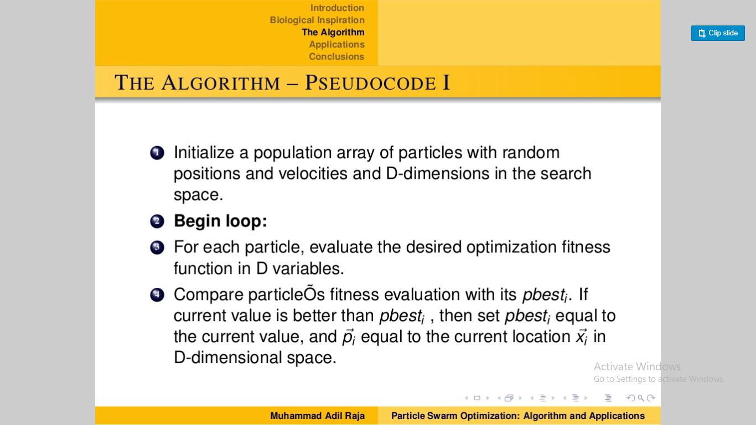

Slide 39
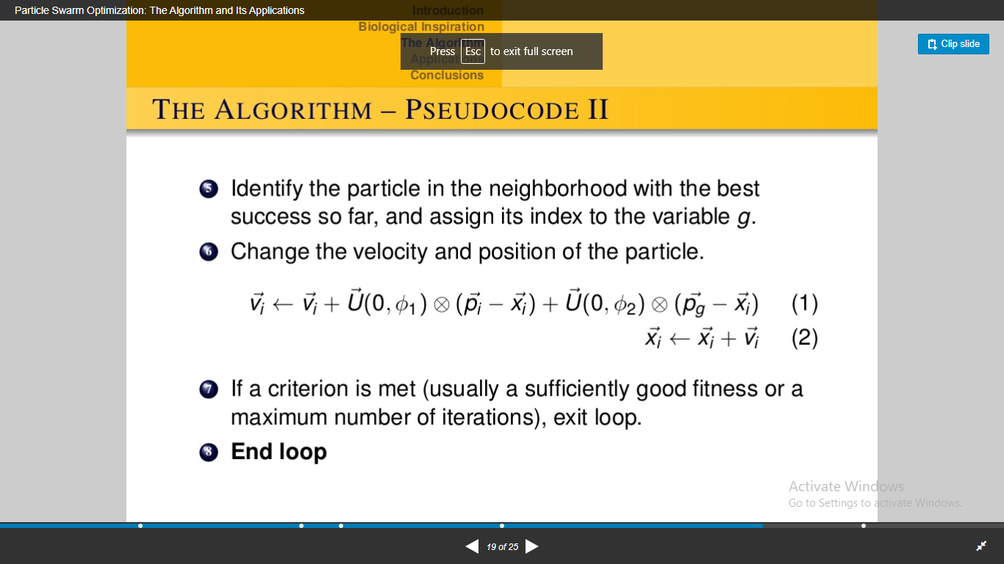

Slide 40
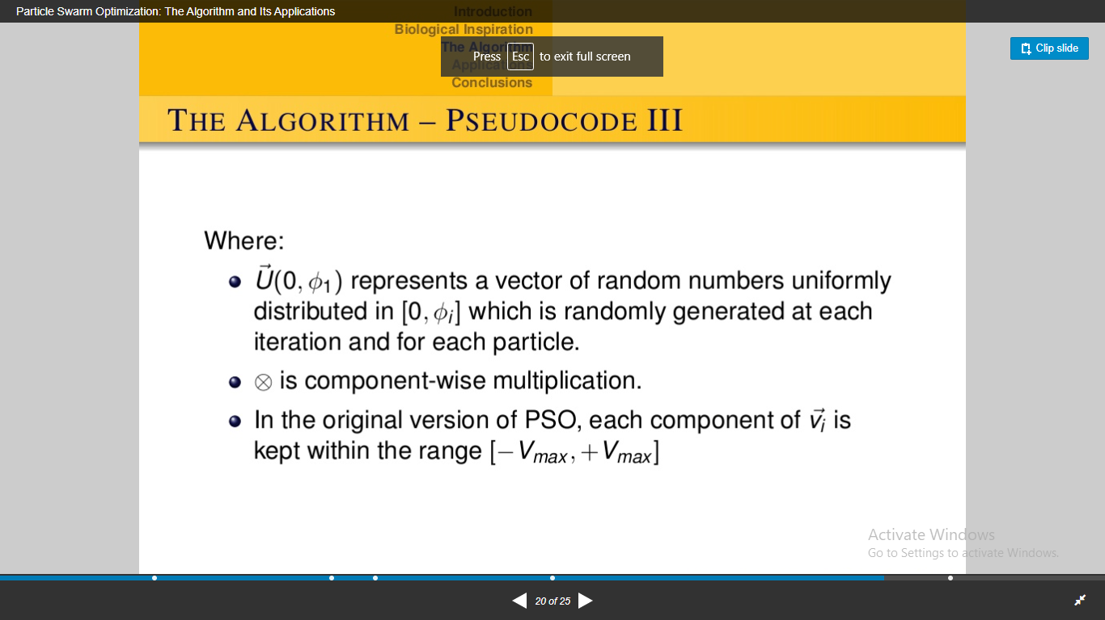

Slide 41
Thankyou !

